Slide 1

What’s the Point of
Charity Fundraising Law?
An assessment of current statutory objectives and an argument for change
Peter Hills-Jones
Chief Executive, Public Fundraising Regulatory Association
(Speaking in a personal capacity)
Notes:
Good morning/afternoon everyone. Can I begin by thanking the Charity Law Association of Australia and New Zealand for organising this event and for their kind invitation to speak here today.
I took over as CEO of the PFRA in November last year, having previously served in the same position for the UK’s own PFRA and as Director of Compliance at the Institute of Fundraising. My background is broadly in regulatory policy and legislation, developed primarily whilst working for the House of Lords Select Committee Office.
I hope today to bring an outsider’s perspective to bear on Australia’s state-based regulatory system and present a personal view on their effectiveness and why I believe change is needed.

Slide 2
State/ Territory | Law | Statutory Objects
ACT | Charitable Collections Act 2003 | To promote proper management and administration of collections; To ensure proper record-keeping and auditing of accounts for collections; To ensure that the public has access to information about collections.
New South Wales | Charitable Fundraising Act 1991 | To promote proper and efficient management and administration of fundraising appeals for charitable purposes; To ensure proper keeping and auditing of accounts in connection with such appeals; To prevent deception of members of the public who desire to support worthy causes.
Northern Territory | No Law | N/A
Queensland | Collections Act 1966 | No Statutory Objects
South Australia | Collections for Charitable Purposes Act 1939 | No Statutory Objects
Tasmania | Collections for Charities Act 2001 | No Statutory Objects
Victoria | Fundraising Act 1998 | Transparency and public confidence in the fundraising industry and in not-for-profit organisations that conduct fundraising; The protection of members of the public from whom money or a benefit is solicited for beneficial or benevolent purposes in the course of fundraising; The protection of the public interest in relation to fundraising.
Western Australia | Charitable Collections Act 1946 | No Statutory Objects
Notes:
Almost all states or territories have their own fundraising legislation, although of those, only three explicitly determine the statutory objects of their laws.
It is nonetheless relatively straightforward to infer from the laws in the remainder of states what those objects are, and they are broadly in line with ACT, NSW and VIC.
Overall, the objectives of all fundraising law can be broadly placed in three groups: proper administration, clear accountability and public protection or protection of the public interest.

Slide 3
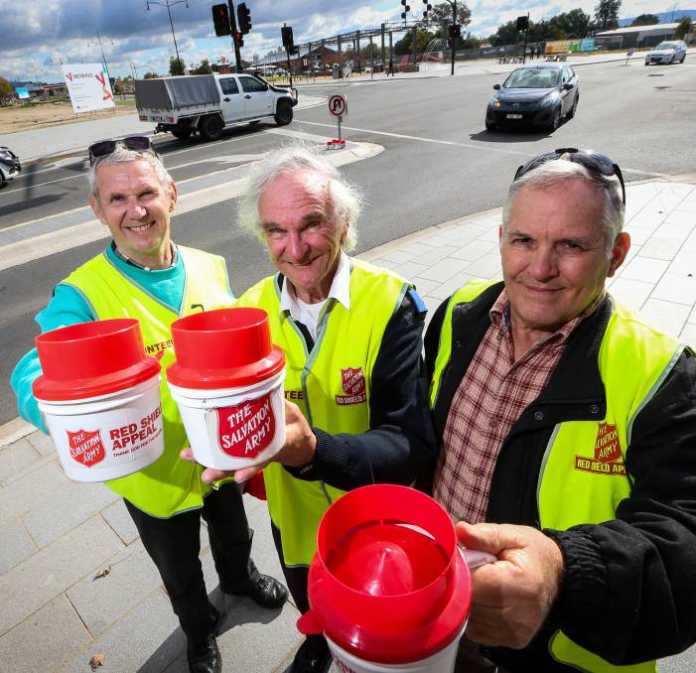
Traditional Arguments to Justify State Regulation of Charity Fundraising
Charities are afforded special tax status and this indirect subsidy brings with it certain mandatory conditions.
Charities as a sector operate under a ‘social contract’ and this is more important and greater than any one charity.
The public must know that the charity they are giving to is genuine and that their money will be used for the purposes solicited.
Notes:
If the state is giving up tax revenue voluntarily, it must do so only when it deems the overall societal benefit (through the existence of charities and more pertinently, their services) is greater than the income foregone.
Effectively this is the bad apple argument writ large. Government has a broad role to play in ensuring the rules of the market are enforced equally to stop bad actors hurting good ones.
This is the ‘trust and confidence’ argument, meaning that the government believes if this measurement is high then people will be more likely to donate. The problem is that there is very little robust evidence or data to suggest this is as direct and linear a relationship as some people think.

Slide 4
Notes:
If we use public trust as a broad indicator of how well the public interest is being served, then this can sometimes be helpful in determining how well the existing laws, regulations and requirements are functioning.
Despite a spate of bad news stories directly impacting the charity sector in the UK – Olive Cooke, Samuel Rae, AgeUK-EoN, Kids Company, Telephone Cold Calling Fundraising, Fundraisers with Criminal Records etc. - confidence in charities remains robust. It fell but has now almost recovered to where it was previously.
2014 – 6.7
2016 – 5.7
2017 – 6.3

Slide 5
Notes:
When looking at the views from within charities however, their view of themselves is more positive (15% more positive).
Interestingly however, they have an even less favourable view of the fundraising industry than the public. 5.5 compared to 5.8.
This correlates with my own experience in the UK, where micro and small charities (who make up the vast majority of the total number of charities) have an increasingly negative view of the larger or super charities (who account for the vast majority of donations).

Slide 6
People’s Words Don’t Always Match Their Actions
Respondents in the same UK survey indicated that a majority trust small charities (57%) over larger ones (34%) and charities that operate in the UK only (61%) over those that operate internationally (31%).
Notes:
The figures shown above are a good illustration of the disconnect between perception and actions. If there was a direct relationship between public trust and confidence in particular types of charity, this should be reflected in the data. It isn’t…
These figures show the top 5 charity sub-sector recipients of donations in the UK in the 4 weeks preceding the survey. The vast majority of which will be constituted of large, national charities and a great many will either exclusively, or substantially, operate internationally.

Slide 7
Notes:
All of the arguments in favour of state regulation however, while not without some merit are based on a fairly outdated view of charities and how they operate.
Charities’ appeals, whether for cash or repeat monthly donations for instance, constitute only a small part of the overall ‘picture’ people have of charities as can be seen in the above graphic.
The legislation outlined in the table was designed, broadly, to regulate large one-off static appeals conducted in public using volunteers and soliciting either one-off cash donations or goods.
Much of the specific rules address for example, ID badges and what must go on pledge forms, which clearly do not apply to vast swathes of fundraising activities. E.g rule-based, rather than principles-based.

Slide 8
Notes:
Data collected by the ACCC suggests that fraudsters are increasingly using face charities as fronts to deceive people. The sums lost to fake charities has for example risen from $67,544 in 2016 to $537,590 so far this year.
The majority of these sums are also being lost via the internet and social networking sites, suggesting that the current legislation has a number of gaps that are being exploited by criminals, in a way that is less possible in person such as face-to-face fundraising.

Slide 9
Notes:
Nonetheless, when it comes to actual donations, direct public appeals in person are still the most effective form of fundraising for charities.
There is therefore still a strong argument in favour of ensuring charities are doing so in a properly managed way. The real debate now though is whether a state-based system in the most appropriate one in the 21st century.
My view is that the most important of the three statutory objects – promoting the public interest, can best be achieved through a new self-regulated Australian Fundraising Standard, underpinned by the Australian Consumer Law and enforced by state regulators and others.
Promotion rather than protection. Protection implies it is a fixed thing, promotion extols the virtue of change.

Slide 10
Public Interest Principles
Charities do not require specific legal mandates to keep proper records of fundraising, this is basic good business practice and can be incorporated into more general annual reporting to ACNC.
Charities and their fundraising partners have a market incentive to maintain effective administration of campaigns as this means lower overheads.
Government poorly defines the public interest and even when it does, this can often become ‘all things to all men’
The public interest is best exercised when it explicitly includes two constituent parts – promoting the public benefit and reducing the public harm.
Notes:
The current laws are heavily weighted in favour of registration and reporting, rather than on improving fundraiser behaviour and standards. This where self-regulation is much more effective and successful.
There is little evidence to suggest that information being provided to state regulators is being systematically analysed or assessed to further any particular public policy objective.
The system needs to be repurposed to provide information to the public, who are the best stewards of the public interest, not government.
PI can be a nebulous concept giving the state freedom to act wherever and whenever it likes, often when under media pressure.
When applied to fundraising, a public interest test should measure the actual public benefit derived from the services charities provide with donations and weigh this against the actual public harm caused by the fundraising activity itself.
This is different however to perceived harm, which can often mean including people’s likes and dislikes – a subjective test that introduces a huge degree of regulatory uncertainty into a market place with tight margins and high pressures.

Slide 11

The Public are the Most Effective Regulators Around
17% of the public say they had a concern about a charity in the past 12 months.
Of those who had a concern, more than half (58%) did not take any action.
Of those who did take action, very few went to independent or external authorities. Instead, they preferred to express their concerns to the charity directly, either by complaining to it or by refusing to donate/unsubscribing from mailing lists.
Notes:
As with most areas of private consumer activity, individuals when acting in aggregate have vastly more economic power than most regulators. Caveat – well functioning markets. Charity market is well-functioning. High competition, strong consumer power. No contracts.
This is no different for charities, where market pressure for transparency and openness has been largely far more effective than any actions taken by government.
The overall aim therefore of charity fundraising law should be to further high quality transparency to allow consumers to make the most informed choice possible.
In this regard, I believe the ACL is a far more appropriate vehicle than the current patchwork of state laws.

